Slide 1
Object-oriented programming and practice using Java
Spring 2014

Slide 2
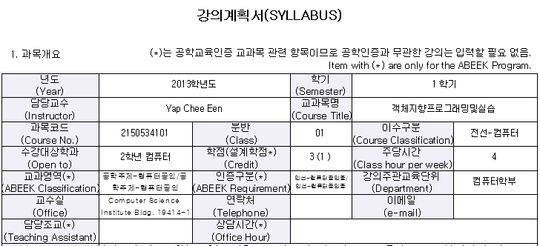

Slide 3
Course Overview
An introduction to Object-Oriented Programming using Java language. Topics covered include the Java programming language syntax, object, class, exception, GUI application, file input/output, data structures. Students will using Eclipse IDE the as the program editor in this course.

Slide 4
Course Objectives
1. Identify and understand the syntax, objects, classes and methods used in Java application development.
2. Program simple Java applications in text based and GUI based format by using predefined Java classes.
3. Compile and execute Java program using Eclipse and implements Object Oriented Programming such as Polymorphism, Encapsulation, Inheritance.

Slide 5
Timetable (2014 Spring)
Monday | Tuesday | Wednesday | Thursday | Friday
OOP (나) 10.30am-12.30pm |  |  |  | OOP (가) 10.30am-12.30pm
21204(Lecture) | OOP (가) 12-2pm |  | OOP (나) 12-2pm | 21203(Lecture)
 | 21205(Lab) |  | 21205(Lab)
OOP (라) 1.30pm-3.30pm
21201(Lecture) |  |  | OOP (라) 3-5pm
 | OOP (다) 4.30-6.30pm |  | 21205(Lab) | OOP (다) 4.30pm-6.30pm
 | 21205(Lab) |  |  | 21203(Lecture)

Slide 6
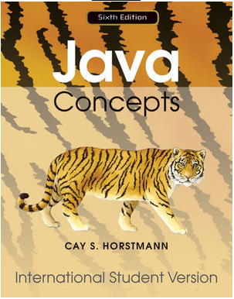
Textbook
JAVA Concepts 6th edition, Cay S. Horstmann, Wiley, 2010
ISBN: 978-0-470-56159-1
Reference Book:
Programming & Problem Solving with JAVA 2nd edition, Nell B. Dale, Jones & Bartlett, 2008
ISBN: 978-0-7637-3402-2

Slide 7
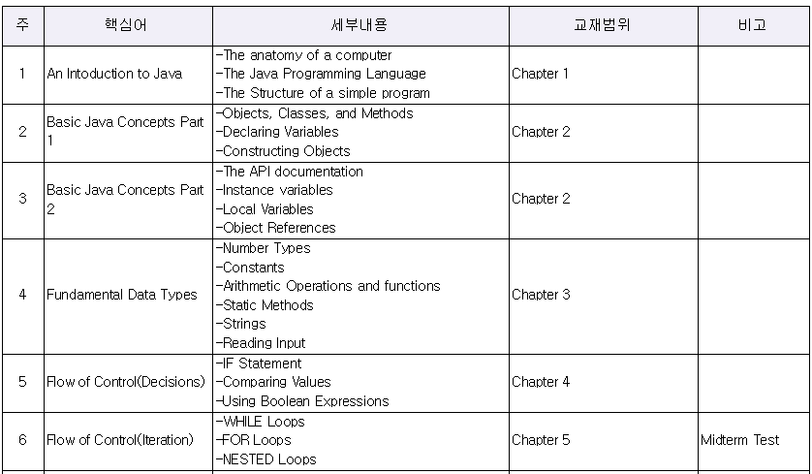
Course Outline

Slide 8
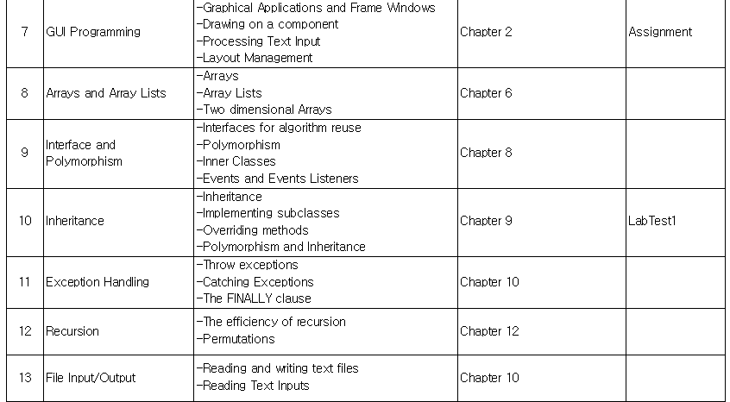
Course Outline

Slide 9
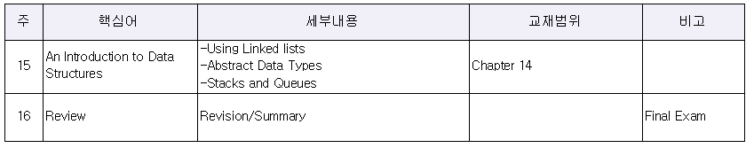
Course Outline

Slide 10

Course Assessment
Components | Mark Distribution
Final Exam | 25
Midterm Test | 15
Lab Test | 10
Assignment | 20
Attendance | 5
Homework And Lab practical | 20
Quiz | 5

Slide 11
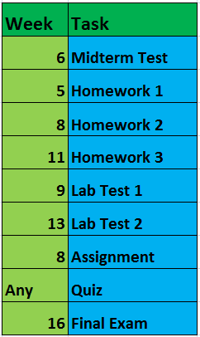
Important Dates

